Slide 1
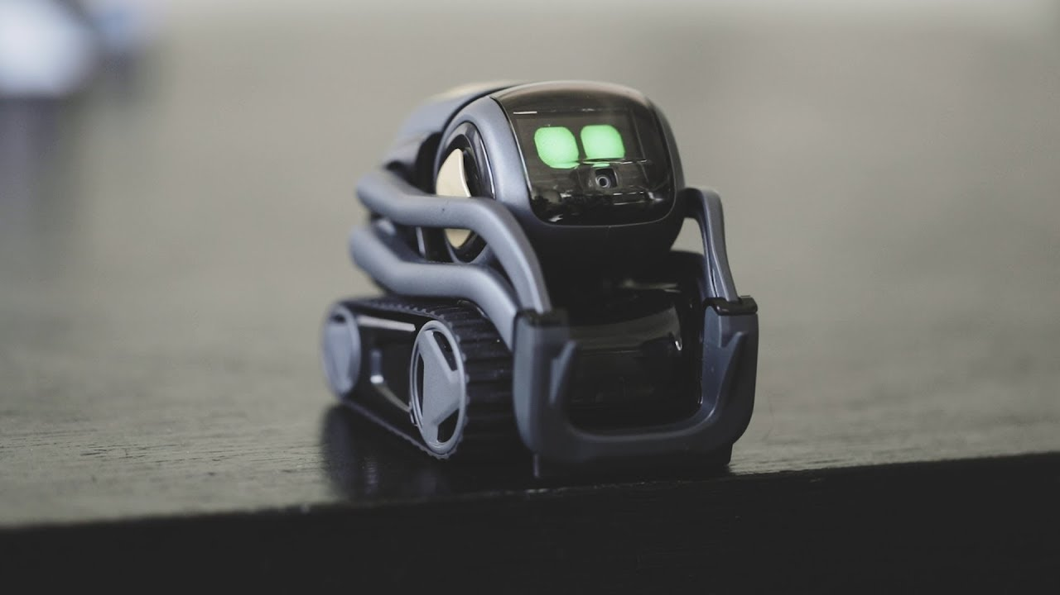
COZMO PROJECT
Andrew, Vincent, Ryan, Luke, Ethan Oh

Slide 2





Overview
Planning
Tasks
Challenges
Solutions

Slide 3

Planning
Name | Date
Ryan | 17 Jan to 21 Jan
Andrew | 21 Jan to 24 Jan
Vincent | 24 Jan to 28 Jan
Ethan | 28 Jan to 1 Feb
Luke | 1 Feb to 5 Feb

Slide 4






Vincent
Tokyo Drift
Ryan
Stack cube when tapped
Pick up and place on selected cubes
Ethan
Luke
Pyramid
Tasks
Avoid cube then stack cube
Andrew

Slide 5





Challenges
Time Constraints
Coding difficulties
Cozmo running out of battery too fast

Slide 6





Solutions
Brainstorm codes together
Doing a schedule
Research guides online
Good preparations

Slide 7


THANK YOU FOR YOUR KIND ATTENTION

